Slide 1

Internal Parameter Fitting
&
SOC Estimation

Slide 2
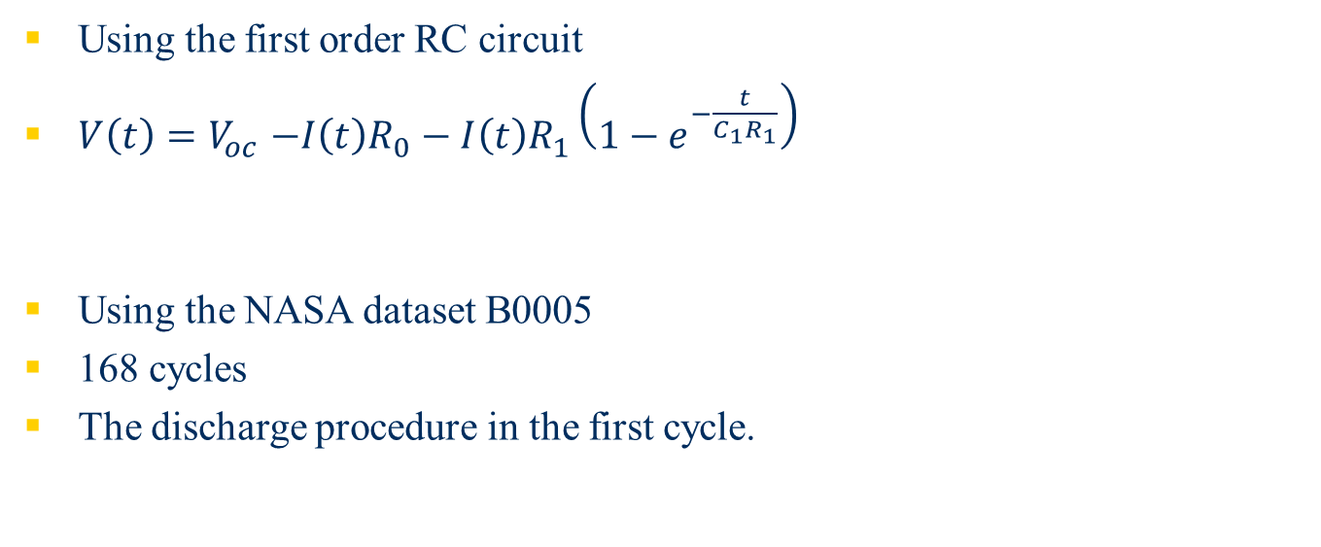
Internal Parameter Fitting
Using the first order RC circuit
$V\left(t\right){=V}_{oc}−I\left(t\right)R_{0}−I\left(t\right)R_{1}\left({1−e}^{−\frac{t}{C_{1}R_{1}}}\right)$
Using the NASA dataset B0005
168 cycles
The discharge procedure in the first cycle.

Slide 3
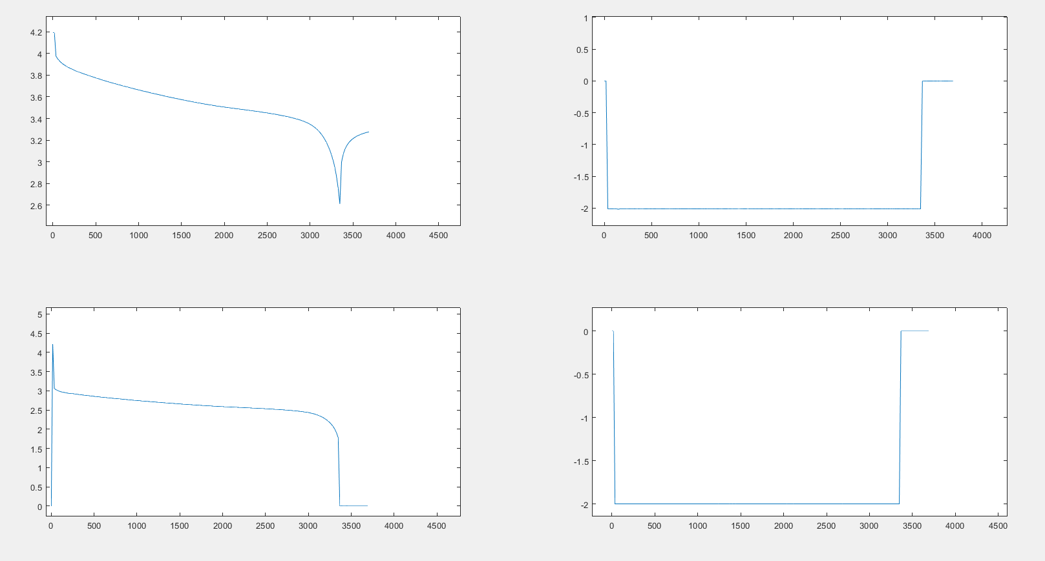
First discharge procedure
Voltage measure (V_oc)
Current measure I(t)
Voltage load (V_t)
Current load

Slide 4
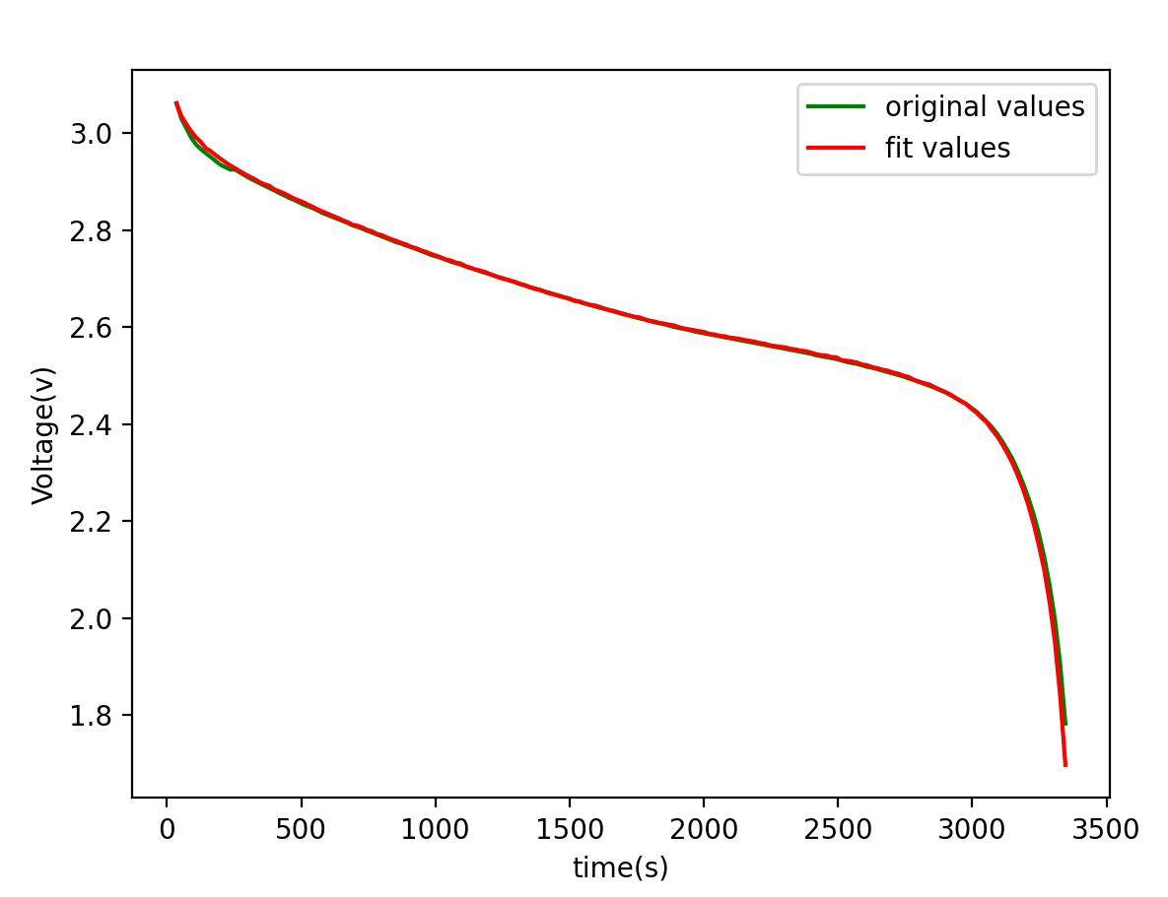
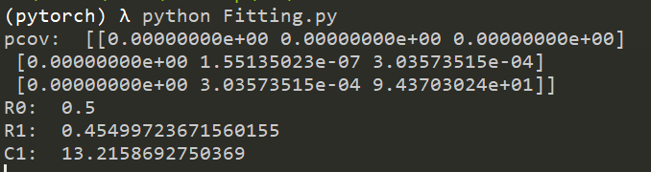

Parameter Fitting
Using Least Square Method
$R_{0}=0.5$
$R_{1}=0.455$
$C_{1}=13.22$

Slide 5
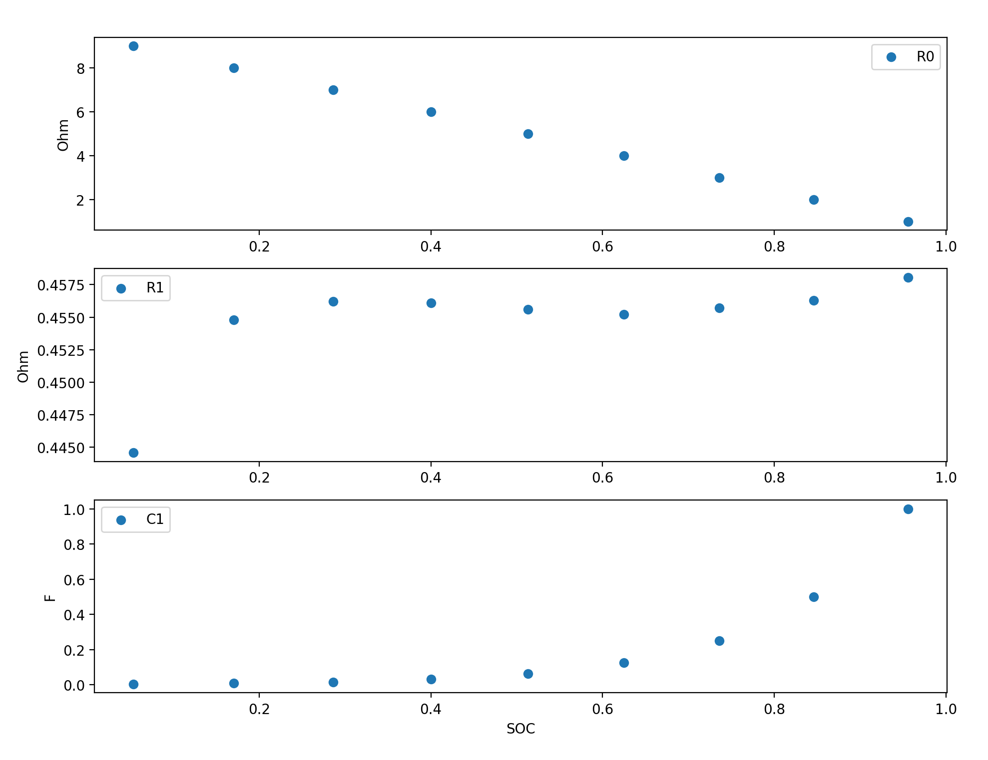
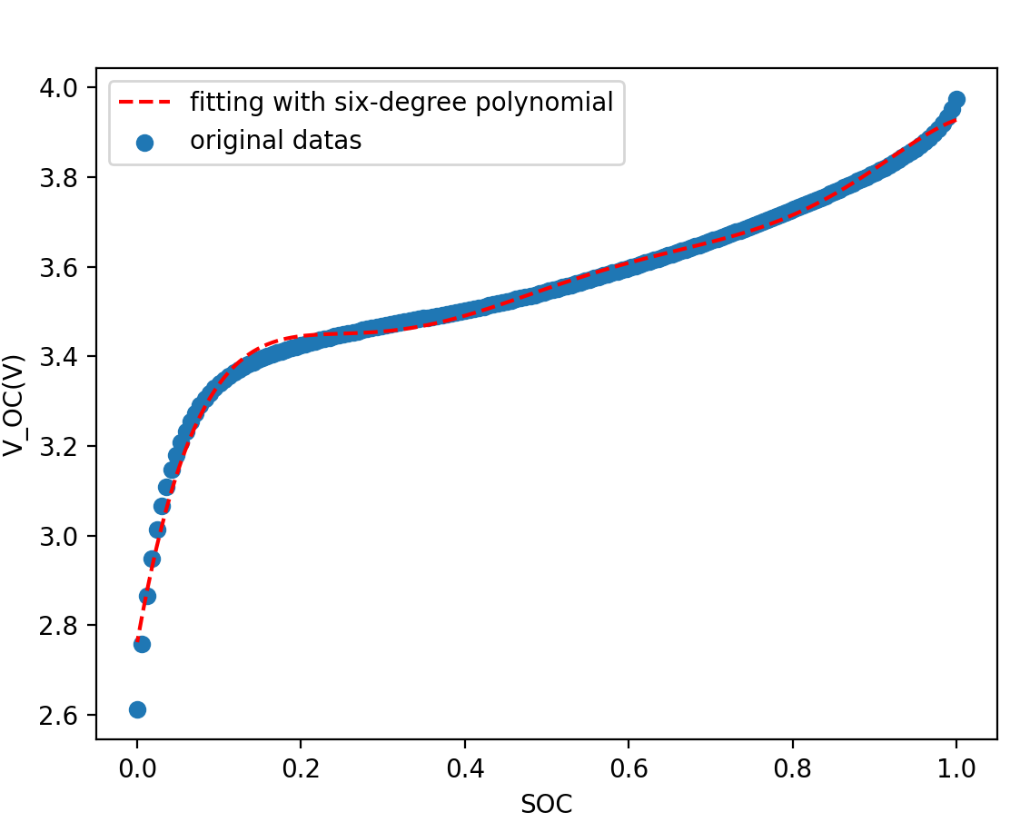
Parameter Changing during one cycle
178 samples in one cycle
Using sliding windows of length 28 : (i-8,i+20）

Slide 6
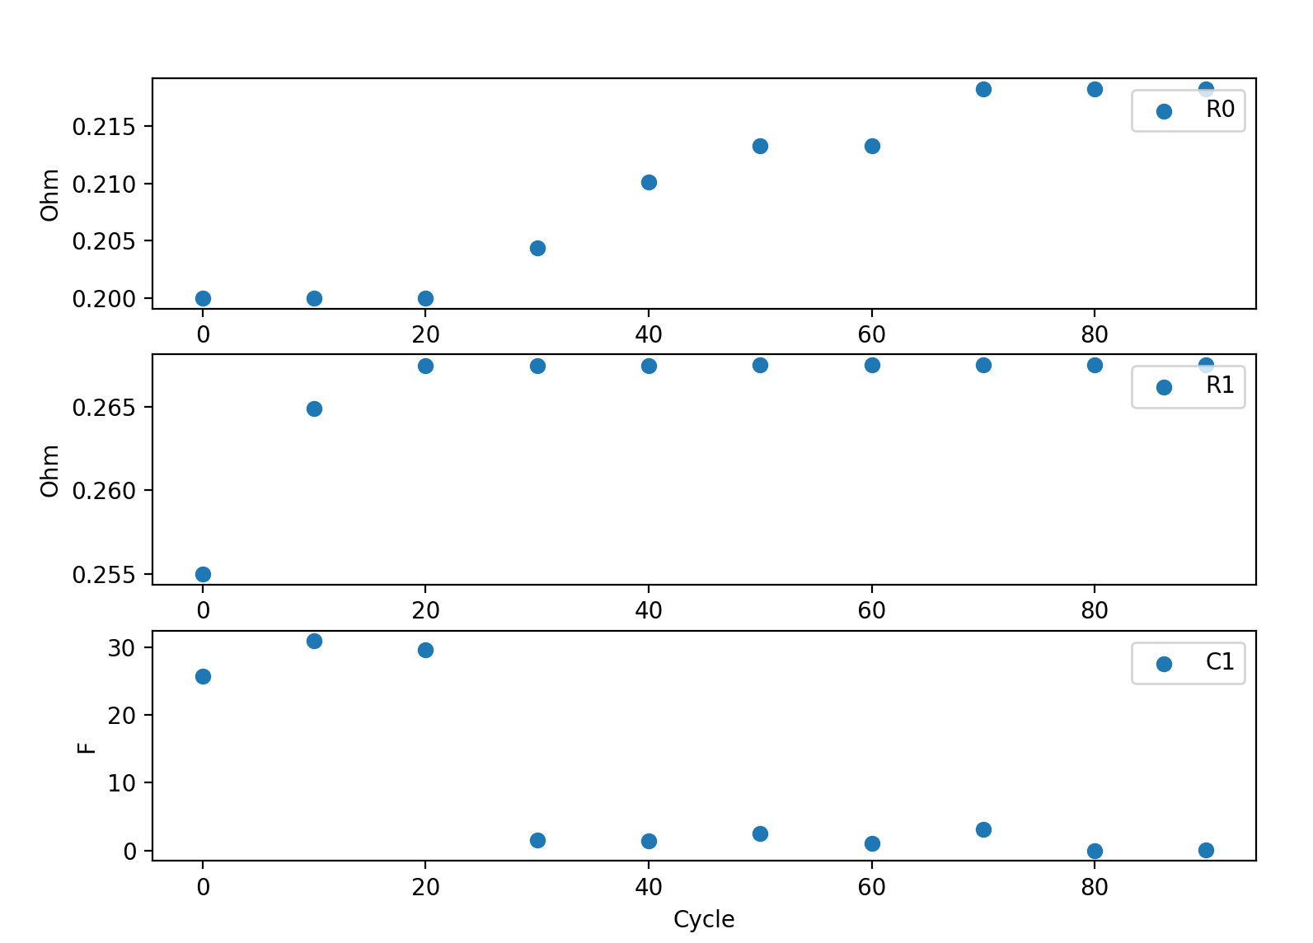
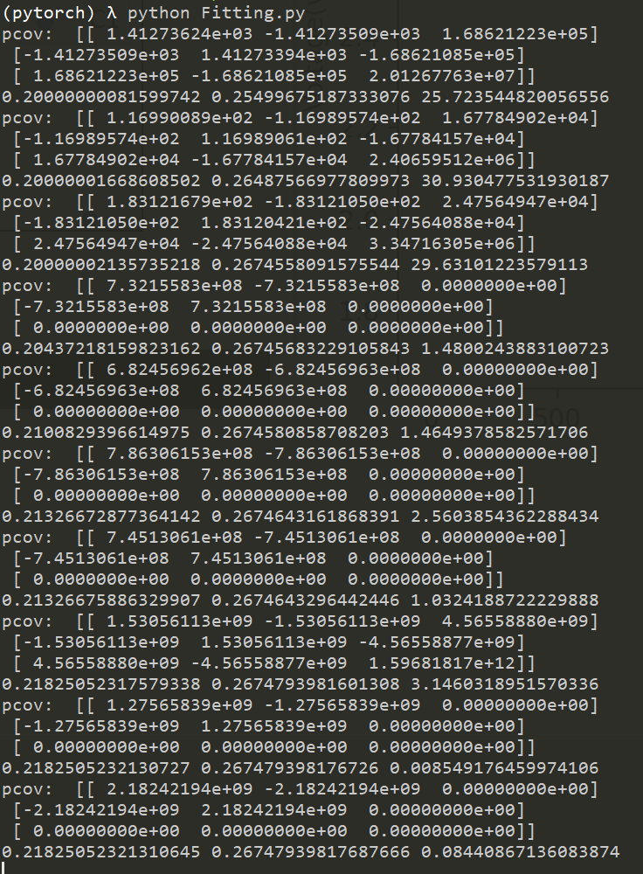
Parameter Changing while aging

Slide 7
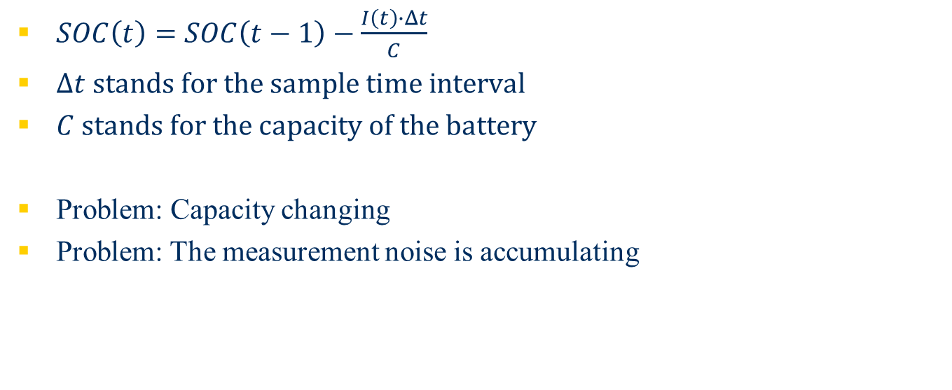
SOC Estimation
$SOC\left(t\right)=SOC\left(t−1\right)−\frac{I\left(t\right)∙Δt}{C}$
$Δt stands for the sample time interval$
$C stands for the capacity of the battery$
Problem: Capacity changing
Problem: The measurement noise is accumulating

Slide 8
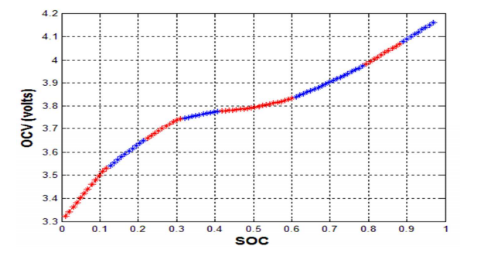

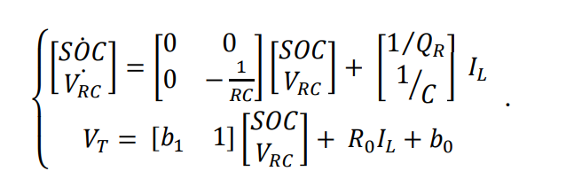
Kalman Filter
Using offline data to get parameters
Calculate SOC based on the iteration of prediction and correction
Try to minimize the noise
H. Rahimi-Eichi, F. Baronti and M. -. Chow, "Modeling and online parameter identification of Li-Polymer battery cells for SOC estimation," 2012 IEEE International Symposium on Industrial Electronics, Hangzhou, China, 2012, pp. 1336-1341, doi: 10.1109/ISIE.2012.6237284.

Slide 9
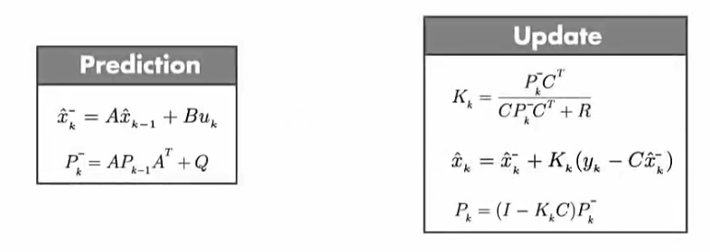
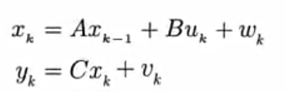

Kalman Filter
Understanding Kalman Filters, Part 3: An Optimal State Estimator. Accessed on: April 7, 2021. [Online]. Available: https://ww2.mathworks.cn/videos/understanding-kalman-filters-part-3-optimal-state-estimator--1490710645421.html
Notes:
https://ww2.mathworks.cn/videos/understanding-kalman-filters-part-3-optimal-state-estimator--1490710645421.html

Slide 10
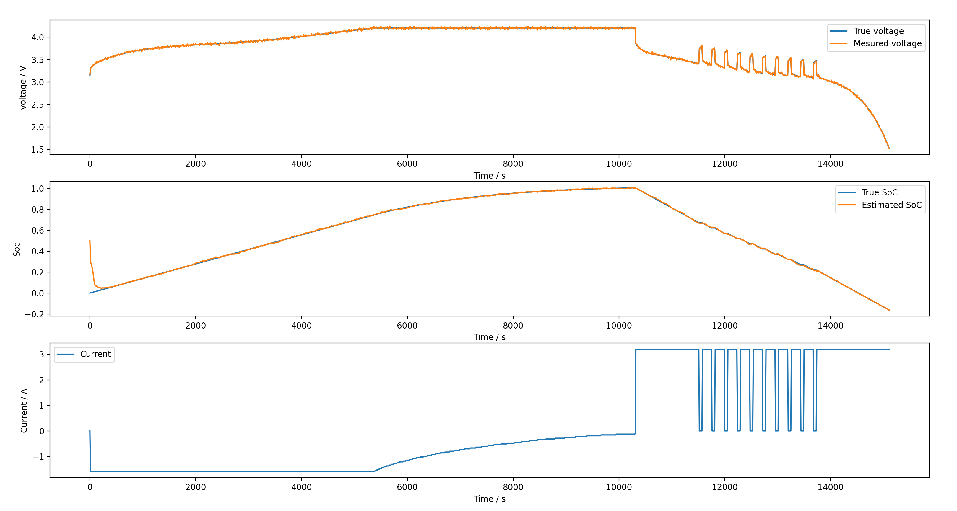
Experiment

Slide 11

Thank you!

